Slide 1
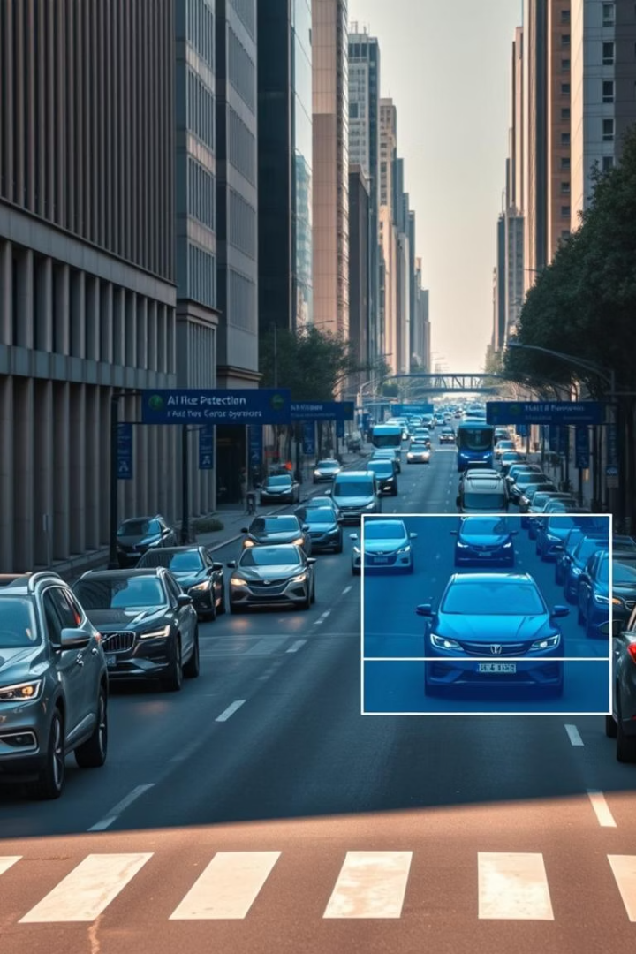


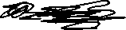

AI-Driven Traffic Violation Detection System
Real-Time Vehicle Monitoring with YOLO, Gemini AI & SQLite
Presented by: ​
Anshaj Shukla(12215469), Isha Sharma(12215892), Sumit Shukla(12221024)
​

Slide 2

Introduction
Traffic Issues
Current Challenge
Violations cause accidents and congestion
Manual monitoring is inefficient
Project Goal
Automate detection: speeding, wrong way, info

Slide 3
Project Objectives
Real-Time Vehicle Detection
Using YOLOv8 for tracking
Violation Identification
Speeding and wrong direction alerts
AI Classification
Gemini AI extracts type, color, brand
Data Storage
Store details in SQLite database
Output
Annotated video with violation info

Slide 4
System Architecture
1
Video Input
YOLOv8 detects vehicles
2
Object Tracking
Estimate speed and direction
3
Violation Detection
Identify rule breaches
4
Gemini AI Analysis
Extract vehicle info
5
SQLite Logging
Store detection data safely
6
Output
Produce annotated video

Slide 5
Technology Stack
YOLOv8
OpenCV & cvzone
Gemini AI (LangChain)
SQLite
Object detection framework
Video processing and overlays
Local storage, thread-safe
Extract vehicle type, color, brand
Detects vehicles accurately

Slide 6
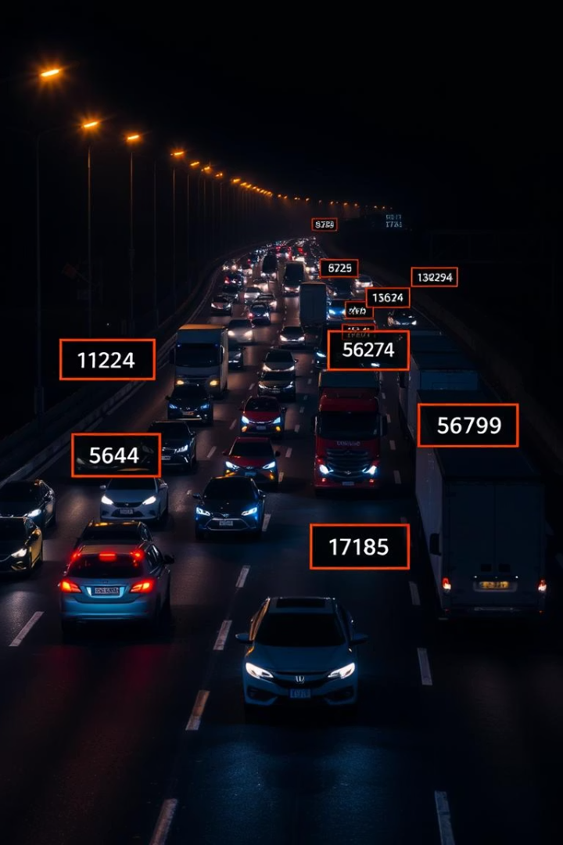
YOLOv8 Vehicle Tracking
Model
Loads lightweight YOLOv8n
Vehicle Detection
Targets car, truck, bike classes
ID Assignment
Unique IDs per tracked vehicle
Visualization
Boxes and labels overlayed on frames

Slide 7

Gemini AI Vehicle Analysis
Image Cropping
Vehicle snapshot extracted
Data Transmission
Base64 image + prompt sent to AI
Information Extraction
Type, color, brand identified
Results Parsing
Structured output from response

Slide 8
SQLite Database Integration
Database
Table
Thread Safety
Name: vehicle_detection.db
vehicles: timestamp, track ID, info
Safeguards with locks during writes
Stores vehicle info & logs

Slide 9
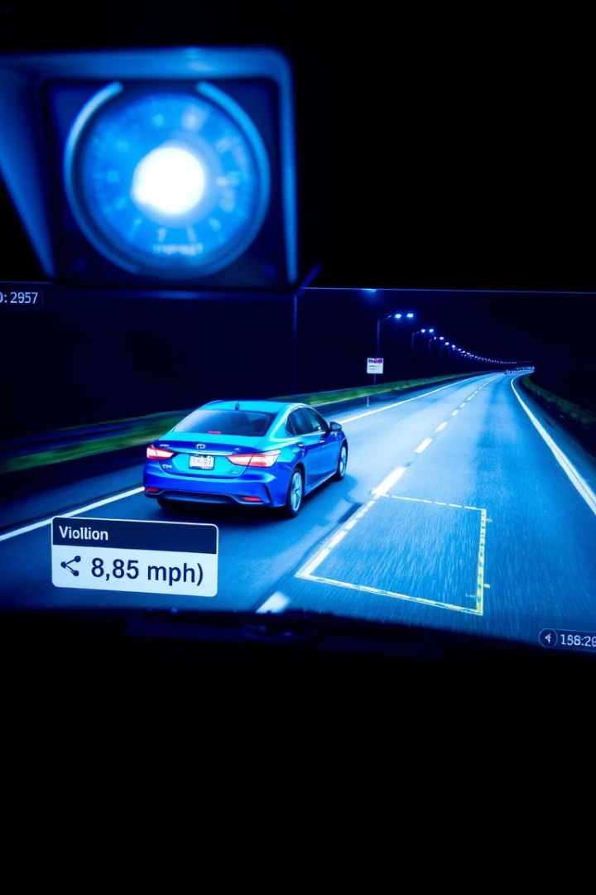




Output and Results
Annotated Video
Custom Zones
Real-Time Detection
Defined polygonal detection areas
ID, Class, Speed, Violations
Low latency monitoring
Reliable Logging
Accurate, thread-safe data storage

Slide 10
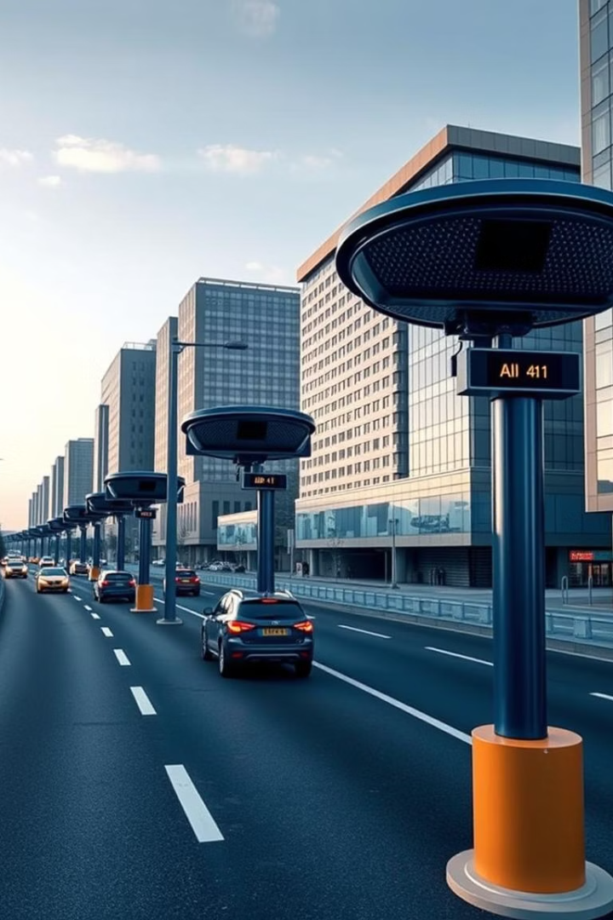
Conclusion
System Accomplishment
Technology Fusion
Real-time AI traffic violation detection
Combines computer vision, NLP, database
Scalability
Suitable for smart cities and roadside deployment

